Slide 1


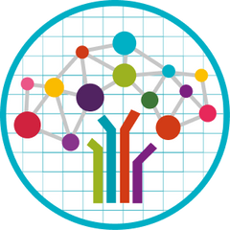


Text to Speech
Presented by : Muskan Saini
Manorma
Project Mentor(s) :
Partha Sarathi Mukherjee
Gurjot Singh
08-11-2024

Slide 2


Problem Statement..
Develop a text-to-speech model that converts text into natural, intelligible speech in real-time, addressing challenges in pronunciation, intonation, and accessibility, particularly for underrepresented languages like Punjabi, to enhance digital inclusivity .
Introduction..
A Text-to-Speech (TTS) system converts written text into natural-sounding speech using deep learning. It begins by processing and normalizing the input text, then applies linguistic analysis to determine pronunciation and prosody. Acoustic features are generated and then converted into audio using neural vocoders like WaveNet. The result is clear, expressive speech that closely mimics human intonation. TTS systems are essential for applications in virtual assistants, accessibility services, and interactive voice-activated platforms.

Slide 3



Project objectives..
Naturalness
Produce speech that sounds natural and human-like, including proper intonation, rhythm, and inflection.
High-Quality Audio Output
Focus on producing clear, high-resolution audio that is pleasant to listen to, minimizing distortions and background noise.
Enable Independent Reading
TTS systems empower visually impaired individuals to independently consume text-based materials without requiring assistance from others.

Slide 4
Datasets Explored..
CMU-synthesis Dataset (15.45 GB)
The CMU-synth dataset is a synthetic Punjabi dataset generated using CMU's Clustergen text-to-speech model.
Drawback: The audio output resembles that of a robotic voice.
Common Voice Mozilla Dataset (99.84 MB)
Common Voice is a publicly available voice dataset, powered by the voices of volunteer contributors around the world
Drawback: A key drawback of this dataset is its limited size, which makes it challenging to train a robust and generalizable model.
Google-synthesis Dataset (4.92 GB)
The Google-synth dataset comprises a synthetic Punjabi dataset that has been generated using Google's Cloud Text-to-Speech service.
Drawback: The audio output resembles that of a robotic voice.
IIT Madras Dataset (13.9 GB) :-
This data was collected on payment basis using the following vendors -- Mediscribe India, Desicrew, and Crescendo to ensure high quality of audio
Drawback: The IIT Madras dataset contains some English words mixed into the Punjabi data.

Slide 5


AI4Bharat Indic -TTS
Deep learning based text-to-speech (TTS) systems have been evolving rapidly with advances in model architectures, training methodologies, and generalization across speakers and languages. However, these advances have not been thoroughly investigated for Indian language speech synthesis. Such investigation is computationally expensive given the number and diversity of Indian languages, relatively lower resource availability, and the diverse set of advances in neural TTS that remain untested. In this paper, we evaluate the choice of acoustic models, vocoders, supplementary loss functions, training schedules, and speaker and language diversity for Dravidian and Indo-Aryan languages. Based on this, we identify monolingual models with FastPitch and HiFi-GAN V1, trained jointly on male and female speakers to perform the best. With this setup, we train and evaluate TTS models for 13 languages and find our models to significantly improve upon existing models in all languages as measured by mean opinion scores. We open-source all models on the Bhashini platform.

Slide 6

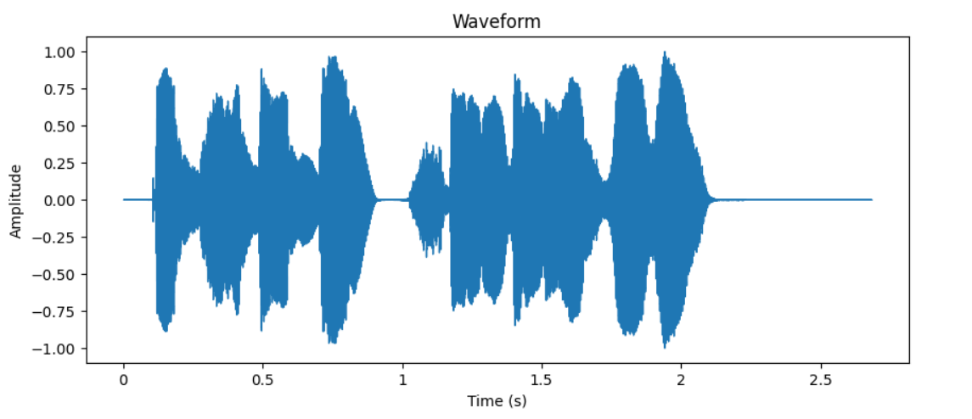

Audio File Analysis..
ਤੁਹਾਡਾ ਦਿਨ ਸ਼ਾਨਦਾਰ ਹੋਵੇ!
Total Duration :2.68 seconds

Slide 7

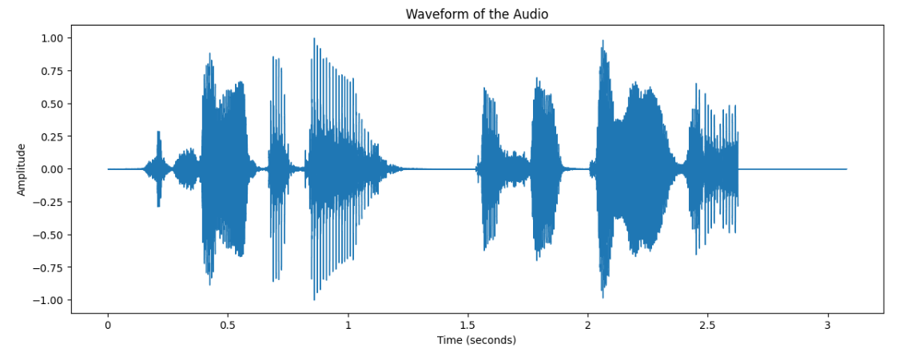
Audio File Analysis..
ਸਤ ਸ੍ਰੀ ਅਕਾਲ, ਤੁਸੀਂ ਕਿਵੇਂ ਹੋ?
Total Duration :3.08 seconds

Slide 8
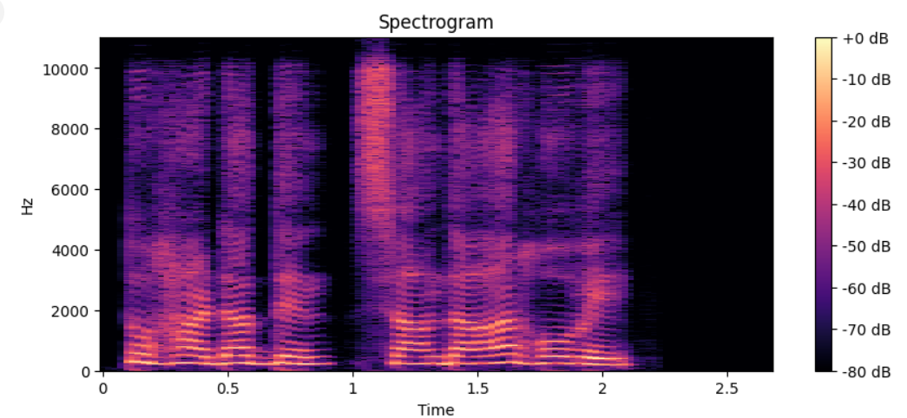
Mel Spectrogram..
A Mel spectrogram is a visual representation of audio frequencies in the Mel scale, which approximates human auditory perception. It captures the power or intensity of various frequencies in the audio signal over time, offering a way to analyze sound in a way that reflects human hearing characteristics.
Mel Scale :- It is a way of measuring sound frequencies that better matches how humans actually hear sounds.
Visualizing a Mel Spectrogram :-
In a Mel spectrogram plot:
The x-axis represents time, showing how sound evolves.
The y-axis represents frequency, but in the Mel scale rather than linear Hertz.
The color intensity represents amplitude, with brighter colors indicating higher intensity (louder parts of the sound).
The legend shows the dB scale, where 0 dB is the highest intensity visible, and -80 dB represents the quietest level shown.

Slide 9

Libraries Required
Here’s an explanation for each library we use:
Jupyter: An interactive computing environment for creating and sharing code, visualizations, and documents.
Librosa: A Python library for analyzing and processing audio and music data.
Pandas: A data manipulation and analysis library, especially for tabular data structures like DataFrames.
PyTorch Lightning: A high-level framework for simplifying PyTorch training workflows, especially for deep learning.
Scikit-learn: A machine learning library for data preprocessing, classification, regression, clustering, and evaluation.
Seaborn: A data visualization library built on Matplotlib, providing high-level interfaces for creating attractive statistical plots.
Soundfile: A Python library for reading and writing sound files in various formats (e.g., WAV, FLAC).
TQDM: A library for displaying progress bars in loops, especially useful for tracking long-running tasks.
TTS: A library for building text-to-speech systems with pre-trained and customizable models.
TensorBoard: A visualization tool for tracking machine learning experiments, especially with TensorFlow or PyTorch.
Weights and Biases (wandb): A platform for tracking and visualizing machine learning experiments in real-time.

Slide 10

FastSpeech
FastSpeech is a non-autoregressive Text-to-Speech (TTS) model designed to overcome the limitations of autoregressive models like slow inference and instability. It uses a Transformer-based architecture for parallel mel spectrogram generation, significantly speeding up the synthesis process. FastSpeech predicts prosodic features such as duration, pitch, and energy using variance predictors, allowing explicit control over these properties for more natural and expressive speech. A length regulator aligns phoneme sequences with target mel spectrogram lengths based on duration predictions. This eliminates the need for complex alignment algorithms used in traditional models. The generated mel spectrograms are converted to audio waveforms using a vocoder such as WaveGlow or HiFi-GAN. FastSpeech produces high-quality, natural-sounding speech, and its parallel processing capability ensures efficiency, making it suitable for real-time applications.

Slide 11
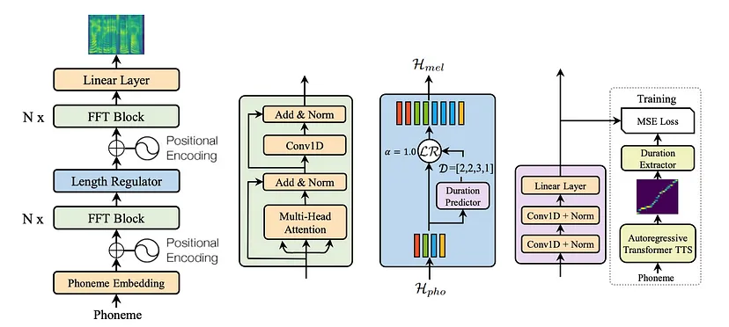
Model Architecture :- FastSpeech

Slide 12
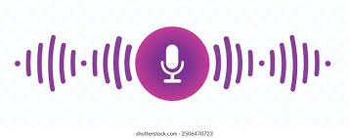
Hifigan
HiFi-GAN (High-Fidelity Generative Adversarial Network) is a state-of-the-art neural vocoder designed for high-quality and efficient waveform generation. It is commonly used in text-to-speech (TTS) and speech synthesis systems. Unlike traditional vocoders, HiFi-GAN leverages GANs to produce realistic audio by training a generator and multiple discriminators simultaneously. The generator predicts raw audio waveforms from mel-spectrograms, while discriminators focus on different scales (such as subband or periodicity) to ensure high fidelity and naturalness.
HiFi-GAN achieves a balance between speed and quality, generating audio faster than real-time without compromising clarity. It uses a multi-receptive field fusion approach, enabling it to capture both local and global audio features effectively. Its architecture significantly reduces artifacts like noise and phase issues common in earlier models. HiFi-GAN is widely adopted for its ability to synthesize speech indistinguishable from human recordings, even for expressive and nuanced inputs. This makes it a cornerstone in modern TTS pipelines.

Slide 13
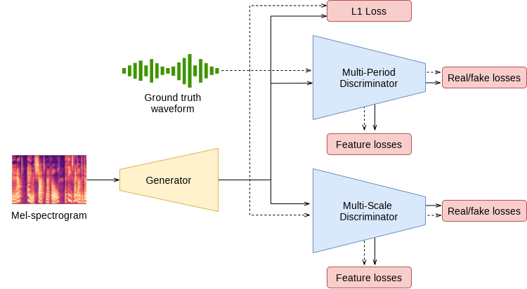
Model Architecture -: Hifigan

Slide 14

User Interface - Streamlit
Streamlit is a popular open-source framework for building data-driven web applications with minimal effort, especially used in Python. It’s widely used for creating interactive dashboards and applications for machine learning, data analysis, and other data-centric tasks.
Key Features of Streamlit:
Simple Syntax: You only need Python code, and Streamlit takes care of the frontend.
Real-time Interactivity: Automatically reruns the app whenever you change the code.
No Frontend Development Needed: No need to learn HTML, CSS, or JavaScript.
Supports Widgets: You can add buttons, sliders, inputs, and more for user interaction.
Integration with Python Libraries: Easily integrates with libraries like pandas, NumPy, TensorFlow, PyTorch, Matplotlib, Plotly, etc.

Slide 15
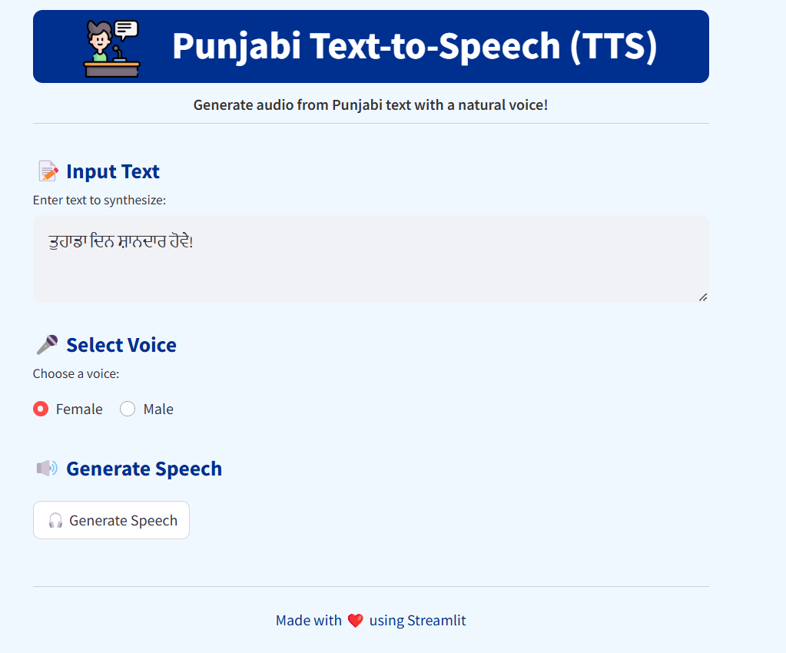
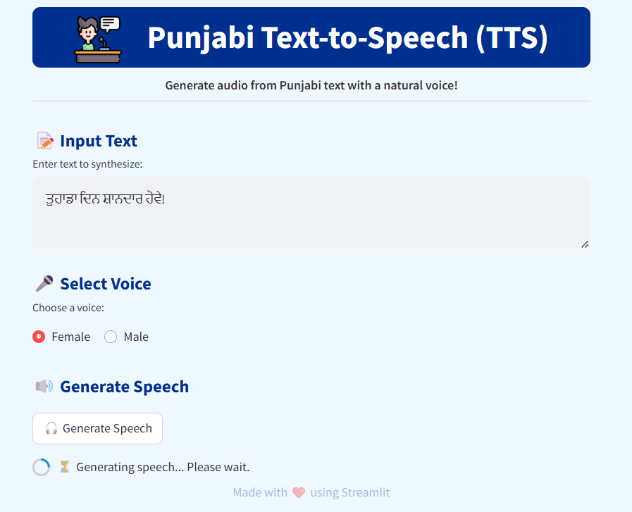
Snapshots

Slide 16
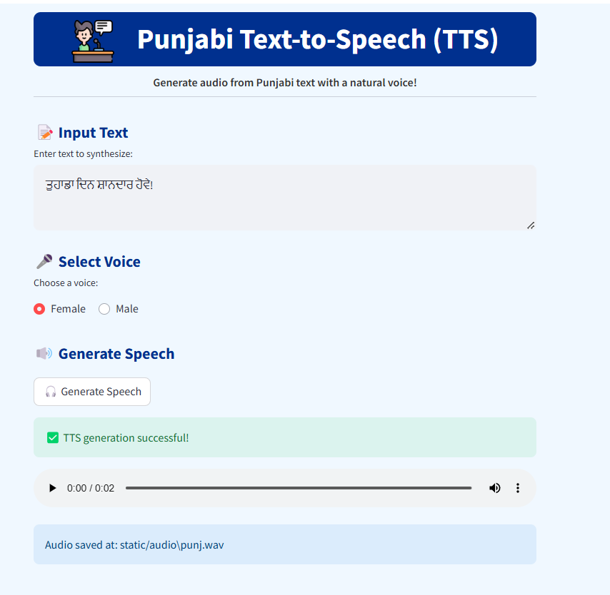

Slide 17

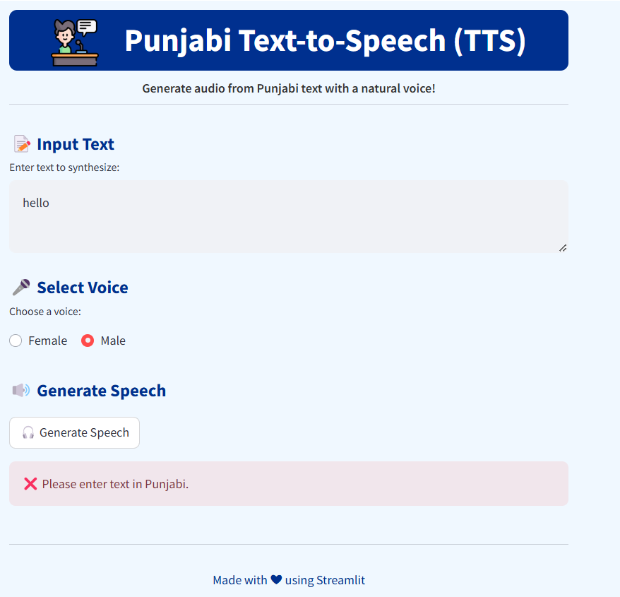
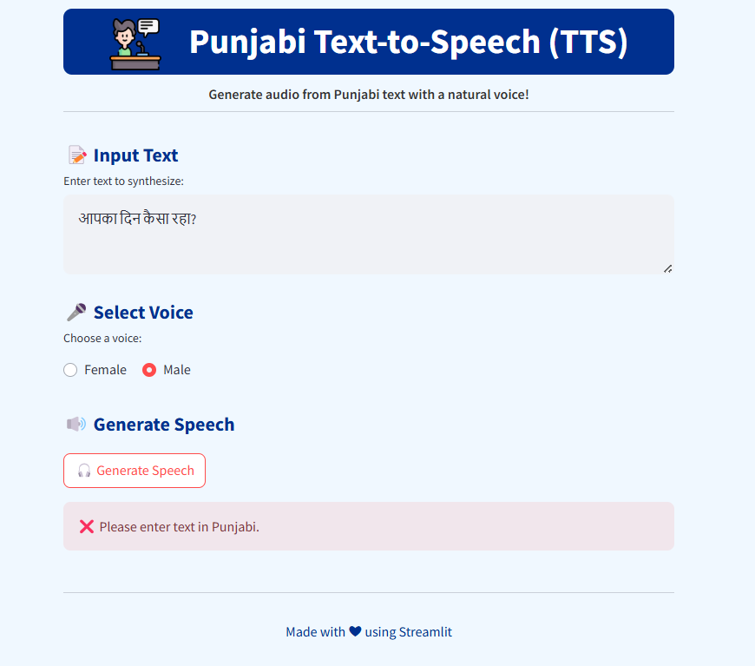
Validation

Slide 18

Use cases
Accessibility for Visually Impaired Users:TTS systems provide accessibility by converting digital text (e.g., web pages, emails, and e-books) into speech, helping visually impaired users to access and interact with digital content independently.
Example: Screen readers like JAWS or NVDA use TTS technology to help visually impaired individuals navigate computers.
Language Learning Tools: TTS can be integrated into educational apps and platforms to help learners hear correct pronunciations and practice listening skills.
Example: Language learning apps like Duolingo use TTS to provide pronunciation examples.
In-Vehicle Systems: TTS can be used in car navigation systems and infotainment systems to read out directions, notifications, or texts to minimize distractions while driving.
Example: GPS navigation systems use TTS to vocalize driving instructions.

Slide 19


Thank you

